Slide 1
Phase II Due Diligence EnCap Upstream Fund XII
1/16/2026
Phase II Score: 79%

Slide 2
Level 1 Brief: EnCap Investments
Level 1 - Pre-Meeting Brief
Prepared by: | ZD, Reviewed by ES
Name / Type: | EnCap Upstream Fund XII (Fund)
Asset Class: | Energy Private Equity
Source: | SL and ZM Relationship
What / Description: | EnCap Fund XII provides capital and works with existing management teams to develop strongly performing O&G assets into attractive acquisitions for large strategic buyers. They build value through property acquisitions, leasehold acquisitions, and acquiring interests in O&G minerals & royalties.
Why / SGG Alignment: | Energy
Who / Credible Team? | Established senior leadership with an average ~20 years at EnCap and strong Energy backgrounds
When / Size Availability : | Target: $4.5B, Closed on $3.5B as of 2024
Why Not / Initial Hurdles | Need to diligence value creation, sourcing ability, and exit strategy
Value-add? / Historical Performance: | Upstream Fund XI – 2017, $7B, 22.2% net IRR MSCI Natural Resources Benchmark: 9.2% median IRR, 22.2% Alpha Upstream Fund X – 2015, $6.5B, 16.4% net IRR MSCI Natural Resources Benchmark: 8.0% median IRR, 8.4% Alpha Upstream Fund IX – 2013, $5B, 10.9% net IRR MSCI Natural Resources Benchmark: 3.7% median IRR, 7.2% Alpha
CIO/Investment Team Review
Initial Recommendation: | 80%: Very interested, would like to move this ahead of other things

Slide 3
Level 2: EnCap (79%)
Level 2 – Due Diligence / Alpha Analysis |  | Score
Returns: Alpha
Quantitative Forecast / Alpha Analysis | Fund Level Alpha (1) – VIII: -14.2%, IX: -4.4%, X: 8.6%, XI: 34.9% Company Level Alpha (1) – VIII: -16.4%, IX: -10.1% X: 10.5%, XI: 23.0% | 70%
PME Analysis | PME Direct Alpha (2) – VIII: -5.1%, IX: 9.4%, X: 10.8%, XI: 16.3% | 80%
Monte Carlo Analysis | Monte Carlo generated a Mean Alpha of 26.9%. | 85%
Returns: Quality
Historical Leverage Used | EnCap targets >1.0x Debt to EBITDA at the portco level. At the fund level, total borrowings cannot exceed $400MM. We do not have portco leverage data. | 80%
Loss Ratio | EnCap has generated a total loss ratio of 25% based on number of deals and 18% based on capital invested. | 70%
Dispersion of Returns (Outperformance) | Investments that have generated greater than a 2.0x MOIC is 73% based on capital invested and 73% based on number of investments. 3.1x outperformance ratio based on number and 2.9x outperformance ratio based on capital invested (outperformance ratio: (% above 2.0x / % held below 1.0x). | 85%
Note: All figures as of June 2024.
Note (1): Alpha analysis and Monte Carlo used the Dow Jones US E&P Index as the benchmark.
Note (2): PME benchmarked against the Nasdaq 100, S&P 500, and S&P E&P index.

Slide 4
Level 2: EnCap (79%)
Level 2 – Due Diligence / Alpha Analysis |  | Score
Opportunity Set | Question: What do they see as their opportunity set? Do we agree? Fund XII will focus on providing growth capital to management teams focused on building upstream businesses in known producing regions in North America that will be attractive acquisition or merger candidates for larger upstream companies. They believe this is attractive because of three reasons: Strong Macro Fundamentals: Oil and gas continue to be the backbone of the global economy, and significant, recurring upstream investment is required to meet projected demand and offset natural production declines of 5-7% annually. However, upstream is highly underinvested. Global capital investment in the upstream sector has been significantly reduced in recent years. The International Energy Agency (IEA) estimates that approximately $650 billion in annual investment is needed through 2030 to meet demand, a 50% increase over recent levels. Competitive Landscape: Access to capital for the E&P industry is very limited. Public equity markets have been largely closed to the sector since 2017, and private equity fundraising focused on upstream oil and gas has slowed considerably. This lack of capital has created a reduced buyer universe and less competition, particularly for larger assets with a total deal size over $500 million. EnCap's reputation, access to capital, and ability to execute quickly are differentiating factors in this environment. Attractive Valuations: Energy and upstream company valuations remain at historically low levels, creating a compelling entry point for investment. The market dynamics allow for the acquisition of properties at attractive multiples, often at or near their "hard value" (2.0x to 3.0x EBITDA). This means the transaction value is supported by existing production, and significant development upside can be acquired for little to no cost. ES/ ZD View: We agree, we think that upstream O&G remains an attractive sector for investment. Energy transition won’t happen for awhile, and O&G will remain a dominant force in energy production. Natural gas will especially still be needed to provide consistent energy to data centers and future infrastructure. | 85%

Slide 5
Level 2: EnCap (79%)
Level 2 – Due Diligence / Alpha Analysis |  | Score
Edge/Team | Question: What do they see as their edge? Do we agree? EnCap’s primary differentiators are its 30+ years of a strong track record of consistent performance and its deeply experienced team. The firm has managed approximately $39B across 22 institutional funds, with its 11 upstream funds generating a net IRR of 14.9% and 1.5x net ROI across 205 investments, consistently outperforming the S&P Energy Index. The leadership team averages 33 years of industry experience and 25 years at EnCap, with the founders having worked together for over 37 years. The team has strong and demonstrated credibility along with significant industry relationships. The firm also has strong operational advantages. EnCap holds board positions in almost all portfolio companies. EnCap also has conservative leverage ratios (currently <1.0x net debt to LTM EBITDA in unrealized upstream portfolio) and has a strong in-house technical team with reservoir engineers and geologists using proprietary software and data for deal evaluation and monitoring assets. EnCap’s technical capability along with the team’s significant industry relationships generates significant deal flow, with approximately half of upstream fund capital allocated to repeat managers. EnCap’s proven adaptability through market cycles positions itself in an advantageous position to continue winning the market. Since 2020, the firm deployed $3.8B in equity while generating $7.4B in distributions, demonstrating their ability to create value even during economic downturns and volatile periods. ES/ZD View: EnCap has a strong edge, they’re unlikely to face real competition from most firms, as they’re an established energy player with a long track record. They have a real ability to consistently generate alpha compared to public energy companies, and the main thing that sets them apart is that they know where to find energy opportunities, regardless of the market conditions. | 80%

Slide 6
Level 2: EnCap (79%)
Level 2 – Due Diligence / Alpha Analysis |  | Score
Investment Process | Questions: Describe how deals are sourced. Overview of the process. EnCap seeks to partner with management teams that have a proven track record of value creation, are industry leaders, and have compelling business plans. EnCap’s partnerships are sourced by the Investment Professionals, who have spent their entire careers developing extensive contacts and relationships within the upstream industry and the broader energy and financial community. Additionally, approximately half of the capital commitments in EnCap’s last four upstream funds were allocated to repeat management teams (teams that EnCap has previously partnered/invested in). EnCap anticipates this trend will continue in Fund XII. ES/ZD View: EnCap has a clear set of criteria they are looking for in management teams. They are focused not on just the assets themselves, but the surrounding team to execute. EnCap repeatedly partnering with past management teams demonstrates both their ability to find strong teams and to really be a value-add partner, as both the management team and EnCap actively choose to work with one another. They are a leader in Energy PE and have a proven ability to source and execute deals. | 80%

Slide 7
Level 2: EnCap (79%)
Level 2 – Due Diligence / Alpha Analysis |  | Score
Investment Process | Questions: How do you underwrite the downside? EnCap's underwriting process is designed to protect capital in declining price environments. Key elements include: Conservative Forecasting: Investment structures are based on conservative forecasts of future oil and gas prices, which are generally at or below current NYMEX prices. The firm's economic modeling includes a suite of sensitivities based on a wide range of prices to stress-test the investment case. "Hard Value" Acquisitions: The firm focuses on acquiring assets at or near their "hard value," where the transaction price is largely justified by the present value of existing Proved Developed Producing (PDP) reserves. This strategy aims to capture future development upside for little to no additional cost, creating a margin of safety Questions: What will they have beta to? The fund's performance is most directly correlated to the public energy sector (S&P 500 Energy Index), particularly upstream exploration and production (E&P) companies. They will also have beta to O&G prices and the O&G industry in general. Questions: What are external return drivers and risk factors we can track (entry multiples, revenue growth, margin growth, market wide vs. industry specific drivers, etc.)? External drivers we can track are strategic M&A activity and multiples in the O&G sector, O&G commodity prices, global energy demand, capital investment into the energy sector, and public O&G company valuations and earnings. | 80%

Slide 8
Level 2: EnCap (79%)
Level 2 – Due Diligence / Alpha Analysis |  | Score
Co-Investment Opportunity | Question: What is their policy on co-invest? What have the historical co-investment opportunities been? EnCap offers co-invest on a no fee, no carry basis. ES View: Need more information historical co-invests and co-invests being offered. | 75%

Slide 9
Timeline
Timing
Phase 1: Pre-Meeting Memo
Phase 2: Prelim DD – Investment
Phase 3: Investment Committee
Legal Commentary Due
Subscription Documents Due
Fund Final Close
Completed
Completed
Completed
n/a
n/a
n/a

Slide 10
Appendix

Slide 11
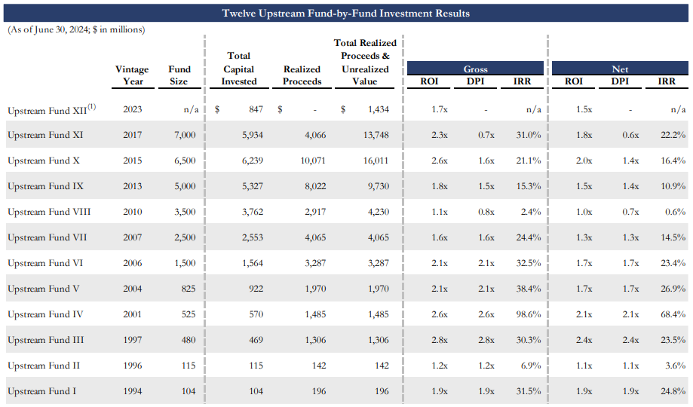
Upstream Track Record

Slide 12
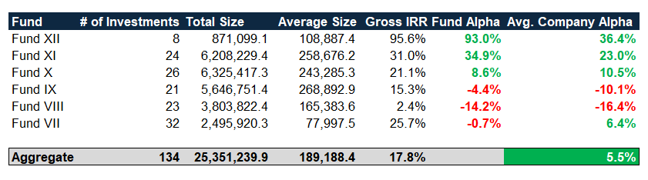
EnCap Alpha Analysis
Note (1): All figures as of June 2024.
Note (2): Benchmark is the Dow Jones US E&P Index.

Slide 13
Batting Average
EnCap’s wins have grown much larger in recent years (since around 2016).

Slide 14
Trailing 20 deals Alpha
EnCap’s Alpha generation has been trending upward since 2016.

Slide 15
Trailing 20 deals Win Rate
EnCap’s win rate has recovered meaningfully from its lows in 2010 and has hit around 80%.
Around 70-80% of the last 20 deals generated >2.0% Alpha.
Note: We define a win as an Investment that generated greater then 2.0% alpha.

Slide 16
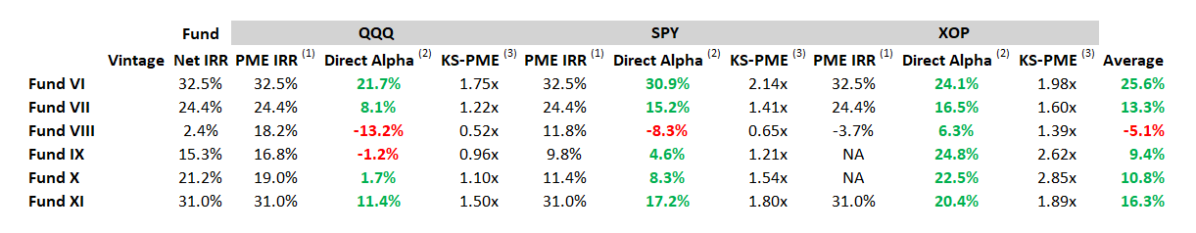
PME Analysis
Note: Indices used are Nasdaq 100, S&P 500, and S&P E&P index.

Slide 17
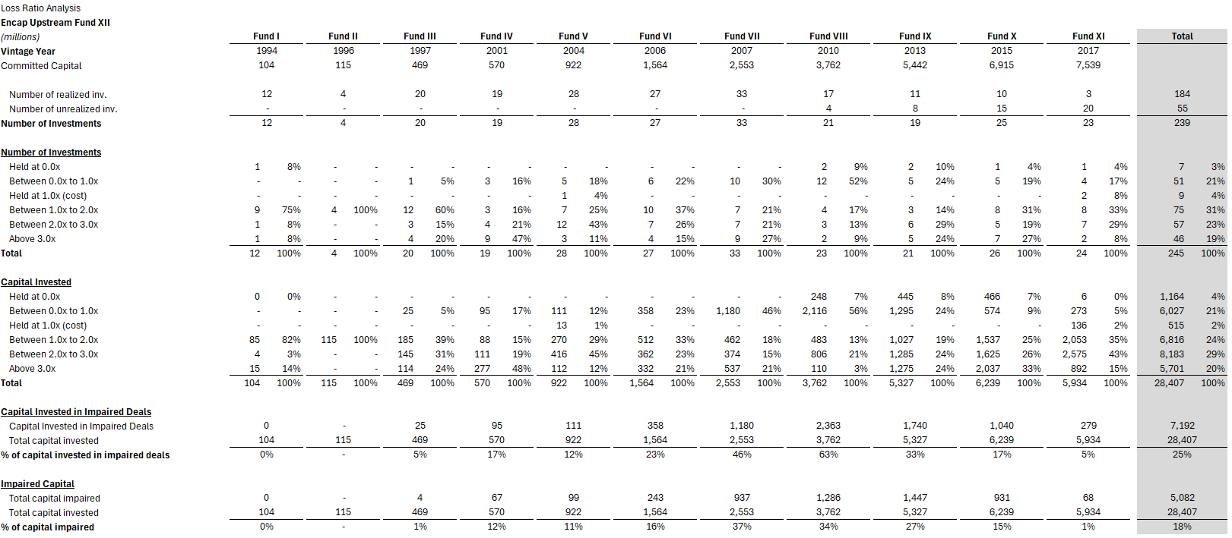
Loss Ratio Analysis

Slide 18
Dispersion of Returns

Slide 19
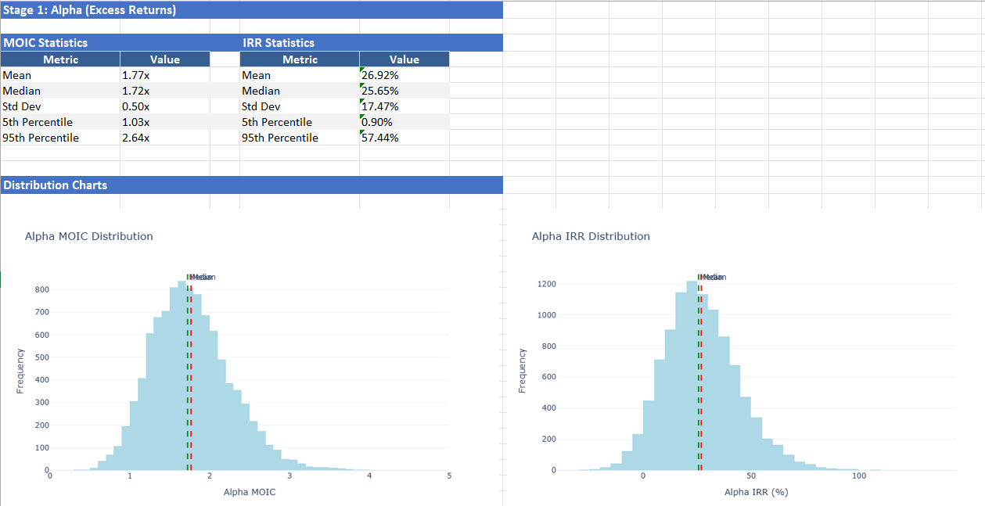
Monte Carlo Alpha Analysis
Note (1): Beta is the Dow Jones US E&P Index.

Slide 20
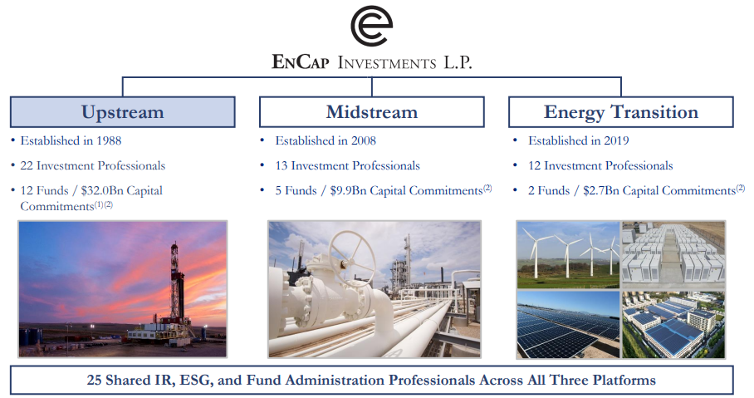
EnCap Organization

Slide 21
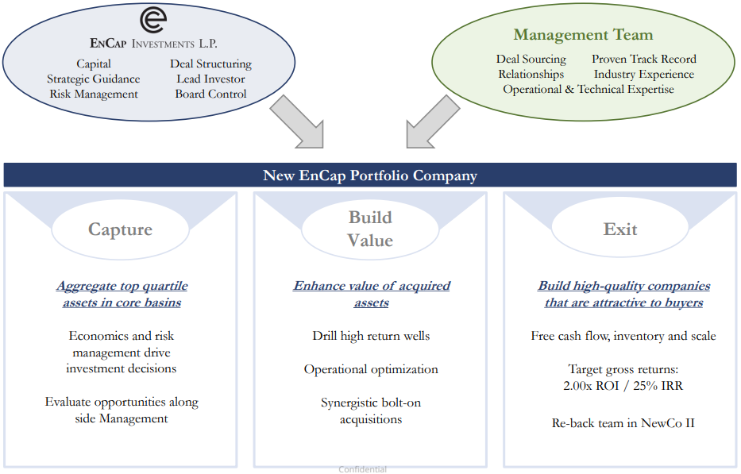
Investment Model

Slide 22
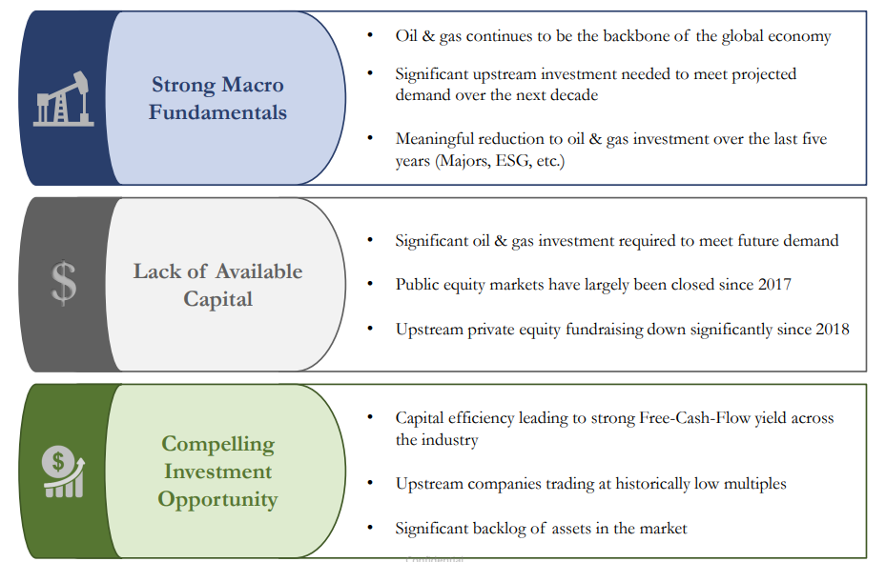
O&G Macro Environment

Slide 23
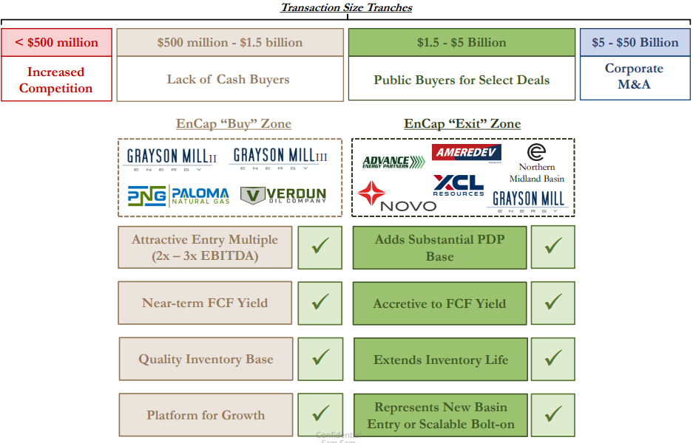
EnCap’s Transaction Size

Slide 24
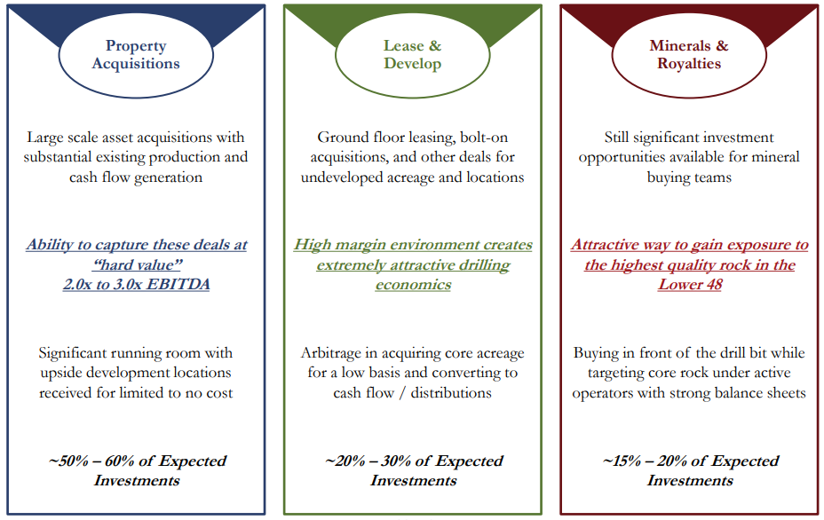
Opportunity Set

Slide 25
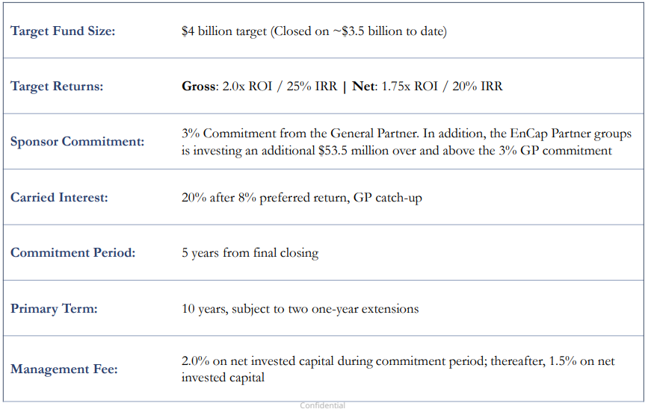
Key Terms

